Slide 1
FIN TECH - FRAUDULENT TRANSACTIONS ANALYSIS AND PREDICTIVE MODEL
Van Duong Ngo

Slide 2
Overview
Exploratory Analysis
01
02
Database, Analytics Approach
Fraudulent Transactions Characteristics
03
Machine Learning
04
Recommendations
A Predictive Model
Outline

Slide 3
01. Overview
!
Object
This analysis provides a holistic understanding of fraudulent transaction characteristics and enables us to identify the optimal predictive model using Machine Learning algorithms
Tool
Python
Skill Stacks
Importing Data – Cleaning Data – Analyzing Data – Visualizing Data

Slide 4
02. Exploratory Data Analysis
2.1.
Fraud Status Proportion
2.2.
Comparison the mean values of descriptive statistics
2.3.
Fraudulent Transactions Characteristics

Slide 5
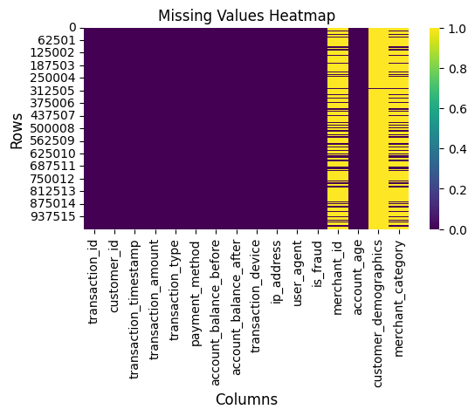
!
Handle Missing Values
Excluded features 'merchant_id’, ‘customer_demographics’, and 'merchant_category’ due to their high percentage of missing values
'transaction_amount' and 'account_age' with a small percentage of missing values were removed the corresponding rows to ensure data integrity and suitability for machine learning training.
The dataset shape after removing missing values: 995 853 entries

Slide 6
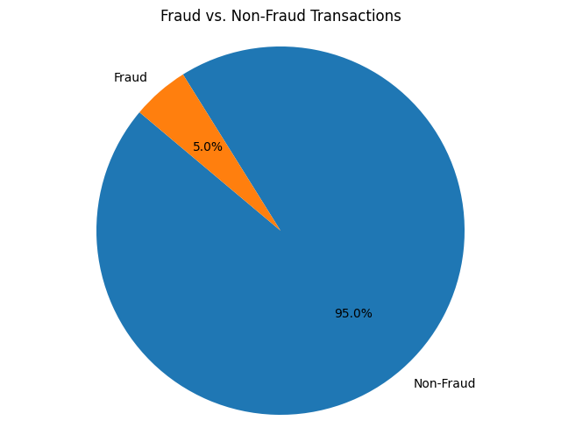
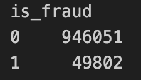
2.1. Fraud Status Proportion

Slide 7
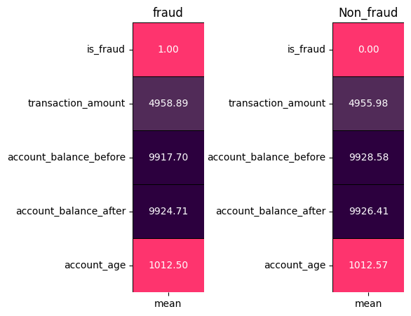
2.2. Descriptive statistics
No significant difference in the average
value between fraudulent transactions
and legitimate transactions.

Slide 8
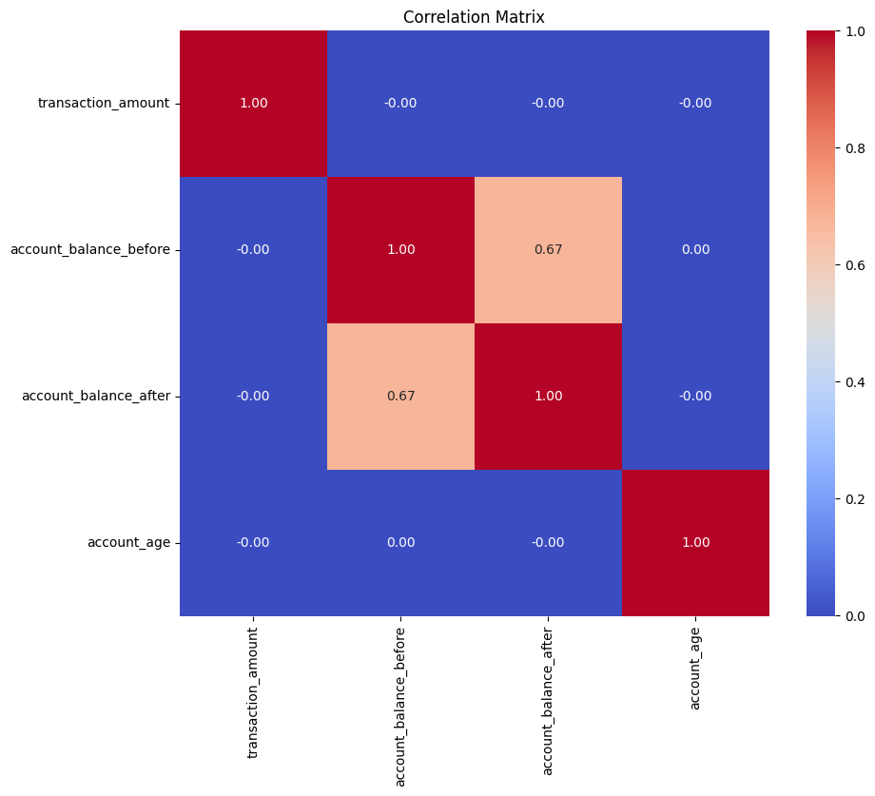
2.3. Fraudulent
Transactions Characteristics

Slide 9
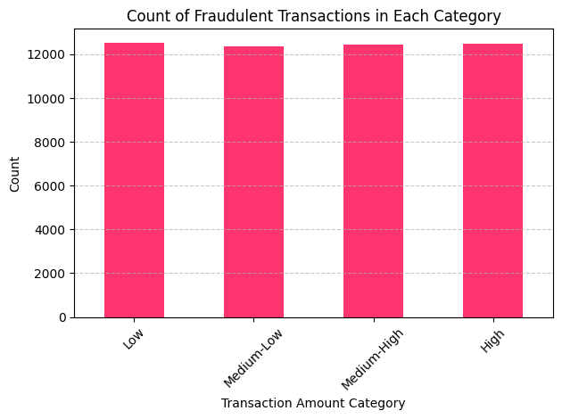
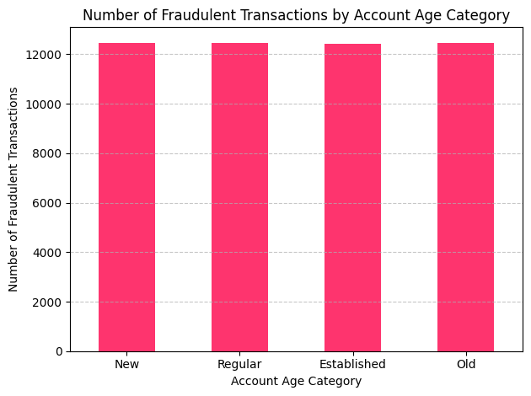
2.3. Fraudulent Transactions Characteristics
New : < 32
Regular : 516 - 1009
Established : 1010 - 1510
Old : > 1511
Low : < 2466.86
Medium-Low : 2466.86 - 4979.12
Medium-High : 4979.13 - 7484.8
High : > 7484.8

Slide 10
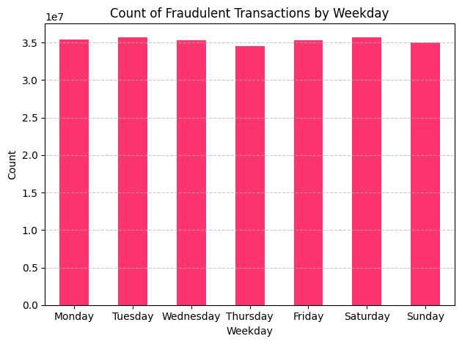
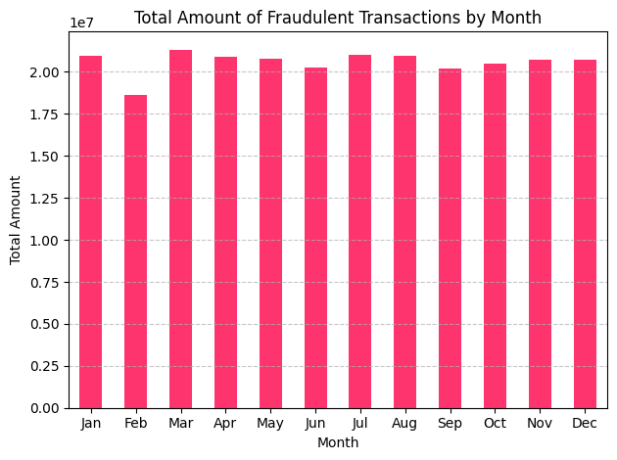
2.3. Fraudulent Transactions Characteristics

Slide 11
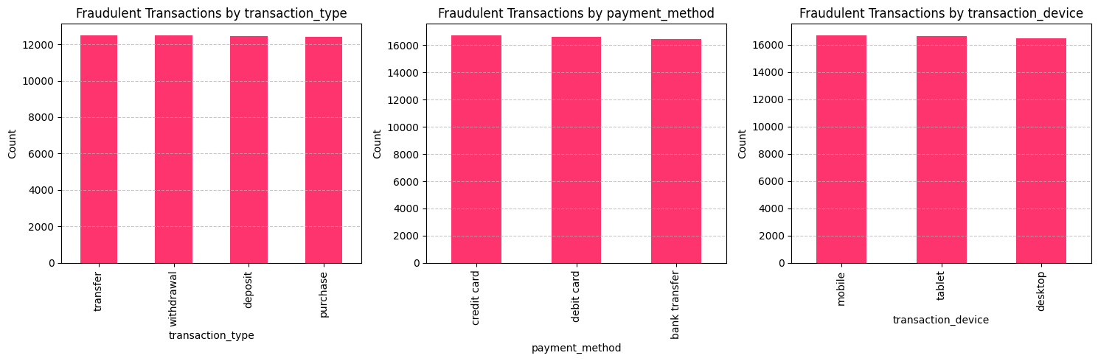
2.3. Fraudulent Transactions Characteristics

Slide 12
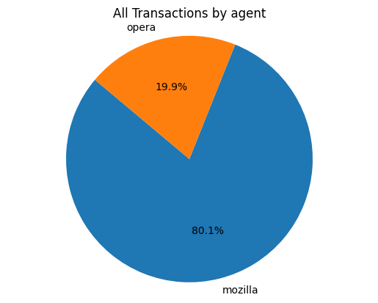

2.3. Fraudulent Transactions Characteristics
It can be seen over 80% of the fraudulent transactions were made through the Mozilla browser.
However, it’s because there were 80% of all transactions made through Mozilla browser.

Slide 13
03. Predictive Model Using ML
3.1.
Why SMOTE?
3.2.
Logistic Regression and Random Forest Algorithms
3.3.
Chosen Algorithm

Slide 14
3.1. Why SMOTE?
The data is suffering from an imbalanced dataset
with the number of fraudulent transactions
recorded in only 5% of the sample.
To tackle this challenge, one widely used approach
is Synthetic Minority Oversampling Technique
(SMOTE). SMOTE is tailor-made for handling
imbalanced datasets by generating artificial
samples for the minority class.
y_train after oversampling distribution:
Counter({1: 757259, 0: 756422})

Slide 15
3.2. Logistic Regression and Random Forest Algorithms
Why were Logistic Regression and Random Forest chosen?
Logistic Regression is a supervised learning technique that is used when the output variable is binary (0 or 1). It means that the result will be either ‘fraud’ or ‘non-fraud’ if a transaction occurs.
Random Forest is capable of capturing non-linear relationships and interactions between features, which is beneficial for fraud detection where fraudulent behaviour may not follow simple linear patterns.
Model Training Preparation:
Shape of X: (995853, 14) - Shape of y: (995853,)
X: ‘transaction_id', 'customer_id','transaction_amount', 'transaction_type', 'payment_method’, 'account_balance_before’, 'account_balance_after', 'transaction_device’, 'account_age','merchant_category’, ‘amount_category','weekday','month','agent_category’
y: 1 - Fraud, 0 – Non-fraud
Create the training and testing sets:
X_train, X_valid, y_train, y_valid = train_test_split(X, y, train_size = 0.8, test_size = 0.2)

Slide 16
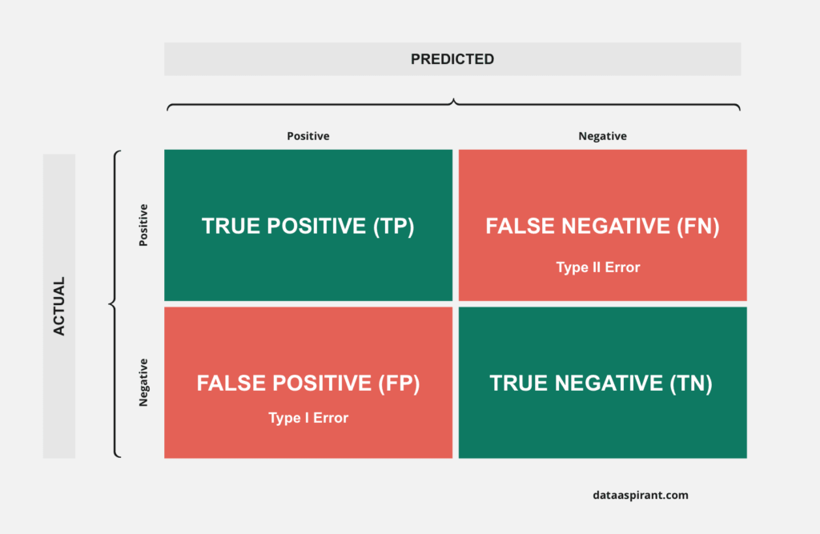
3.2. Logistic Regression and Random Forest Algorithms
How to evaluate the algorithms
Precision: It measures the proportion of true positive predictions among all positive predictions, indicating the model's accuracy in predicting positive instances.
Recall: It measures the proportion of true positive predictions among all actual positive instances, indicating the model's ability to capture all positive instances.
F1-score: It is the harmonic mean of precision and recall, providing a balanced measure of a model's performance across precision and recall.
Accuracy: It calculates the ratio of correctly predicted instances (both true positives and true negatives)
TP: True prediction of Fraud
TN: True prediction of Non-fraud

Slide 17
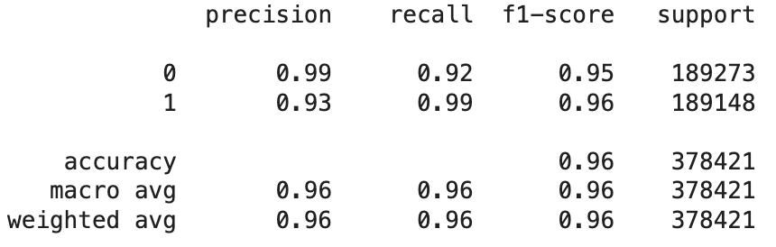
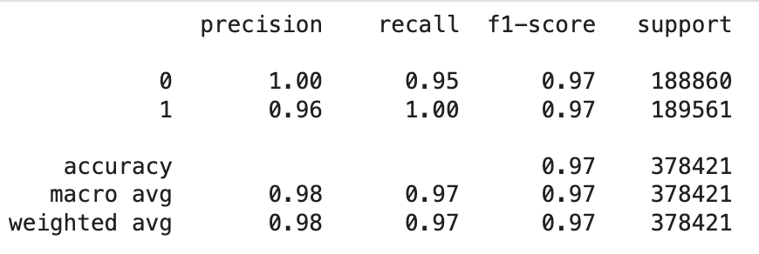
3.2. Logistic Regression and Random Forest Algorithms
Classification Reports
Logistic Regression
Random Forest

Slide 18
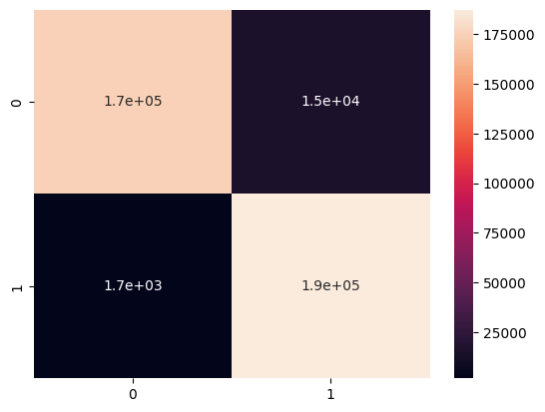
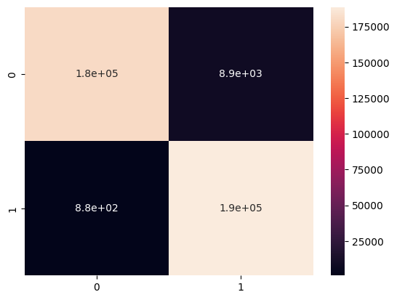
3.2. Logistic Regression and Random Forest Algorithms
Confusion Matrix
Logistic Regression
Random Forest

Slide 19
3.2. Chosen Algorithms
Random Forest Classifier using SMOTE gives the higher precision, recall, f1 score, and accuracy of about 97%.

Slide 20
04. Recommendation
Data Disparity: Fraudulent transactions are only 5% of the dataset, highlighting the need for enhanced scrutiny to uncover patterns and improve reliability.
Browser Insight: While other parameters show no significant patterns, 80% of fraudulent transactions occur via Molliza browser, suggesting the need for extra scrutiny on transactions made through it.
3. Machine Learning Recommendation: Utilizing the Random Forest algorithm with SMOTE is recommended for predicting and detecting future fraudulent transactions.

Slide 21
THANK YOU

